Slide 1
OWNING THE CLOUT THROUGH SSRF
AND PDF GENERATORS
Ben Sadeghipour
Cody Brocious

Slide 2


WHO ARE WE
Head of Hacker Operations at HackerOne
Top 20 hacker on HackerOne
Snapchat, Yahoo, DoD, Airbnb, Valve, etc.
Youtube/Twitch/social media: @NahamSec
Ben Sadeghipour
Head of Hacker Education at HackerOne
Not top 20 on HackerOne
Hotel locks, Nintendo Switch, iTunes, etc.
Twitter: @daeken
Cody Brocious

Slide 3
SSRF According to OWASP
In a Server-Side Request Forgery (SSRF) attack, the attacker can abuse functionality on the server to read or update internal resources. The attacker can supply or a modify a URL which the code running on the server will read or submit data to, and by carefully selecting the URLs, the attacker may be able to read server configuration such as AWS metadata, connect to internal services like http enabled databases or perform post requests towards internal services which are not intended to be exposed.
TL;DR: Make requests using the target host and in some cases render JS server side

Slide 4
What is Cloud Metadata?
169.254.164.254 is accessible internally within the machine you have access to.
Provides details like internal IP, hostname, project details, etc.
And if you’re lucky enough, it could also give you access to access_key & secret_key as well

Slide 5
Basic Example
Upload avatar via URL and triggers the following request:
GET /api/v1/fetch?url=https://site.com/myfunnycatmeme.jpeg
Host: thesiteweareabouttpwn.com
Changing the URL parameter to something.internal.target.com may give us access to see internal assets
Not limited to http, you can use other protocols
file:///etc/passwd
gopher://
ssh://
… But it’s not always that easy

Slide 6
CVE Examples

Slide 7
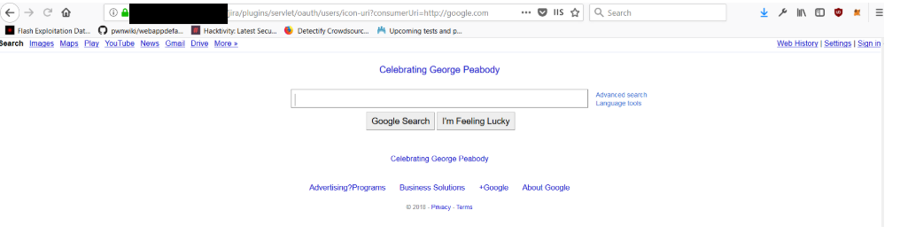
CVE Examples
Similar to previous slides
JIRA CVE-2017-9506
Pointing consumerUri to Google
https://medium.com/bugbountywriteup/piercing-the-veil-server-side-request-forgery-to-niprnet-access-c358fd5e249a

Slide 8
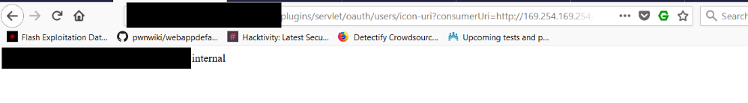
CVE Examples
Similar to previous slides
JIRA CVE-2017-9506
Metadata
https://medium.com/bugbountywriteup/piercing-the-veil-server-side-request-forgery-to-niprnet-access-c358fd5e249a

Slide 9
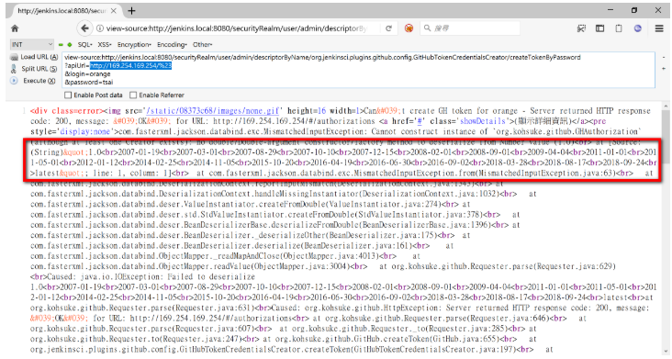
CVE Examples
Similar to previous slides
Jenkins - CVE-2018-1000600
Pointing apiUri to AWS Metadata

Slide 10
SSRF Hurdles
Sometimes it’s not as straightforward as a single http request. In some cases you may be dealing with filters or you may not even see the output of your request but you still have a few options

Slide 11
SSRF Hurdles
Problem: metadata or internal IPs are getting filtered
Solution: Use a custom domain like meta.mydomain.com and point it to the asset you are trying to access (aws.mydomain.com -> 169.254.169.254)
Problem: Only able to use whitelisted domains
Solution: Find an ‘Open Redirect’ on the whitelisted domain(s) and use that to exploit your SSRF
Problem: SSRF is there but I can’t see the output
Solution: Use Javascript and exfil data
Notes:
Sometimes it’s not as straightforward as a single http request. In some cases you may be dealing with filters or you may not even see the output of your request but you still have a few options:

Slide 12
Valuable Assets / Vulnerabilities
XSS on the target application where it also gets pushed to the PDF
How to confirm it: <script>document.write(123)</script>
Generate PDF and it should print 123
Follows redirection by pointing the url or HTML tag (iframe/img etc) to our host where redirect.php redirects to success.php
mysite.com/redirect.php -> redirects to mysite.com/success.php
Any customization that involves HTML/CSS (Font name, colors, styling)
Open redirect on the target application in case of any domain whitelisting

Slide 13
PDF GENERATION PROCESS

Slide 14
Headless Browsers
There are two common headless browsers in use:
wkhtmlpdf is a Webkit implementation whose rendering backend is PDF.
Headless Chrome is desktop Chrome minus the GUI and with a PDF or image rendering backend attached.
Lots of wrapper libraries providing easy integration with any language
Notes:
There are two common headless browsers in use, with lots of wrapper libraries providing easy integration with any language you can imagine. These are both serious browsers with all of the baggage that implies.

Slide 15
HTML Renderers
Rather than using an actual browser engine, these renderers work by doing the HTML and CSS parsing, without any kind of JavaScript support or dynamic layout engine.
tend to provide a restricted environment where most HTML can be handled safely and efficiently
WeasyPrint is a great example of this class of HTML->PDF converters (more later)
Notes:
Rather than using an actual browser engine, these renderers work by doing the HTML and CSS parsing, without any kind of JavaScript support or dynamic layout engine. These tend to provide a restricted environment where most HTML can be handled safely and efficiently.
WeasyPrint is a great example of this class of HTML->PDF converters, which we’ll talk about in more detail later.

Slide 16
XSS in PDF Files

Slide 17
PDF + XSS == SSRF
Most modern web applications performing PDF generation do not actually generate PDFs directly.
As such, any XSS into this data gets you running in the context of the server -- not the client!
The attack strategy used will depend on what conversion system is in use in the application, but these can be broken into two categories: Headless browsers and HTML renderers.
Notes:
Most modern web applications performing PDF generation do not actually generate PDFs directly; this requires a lot of hand tweaking, generation of completely separate templates, etc. Instead, they perform HTML->PDF conversion. As such, any XSS into this data gets you running in the context of the server -- not the client!
The attack strategy used will depend on what conversion system is in use in the application, but these can be broken into two categories: Headless browsers and HTML renderers.

Slide 18
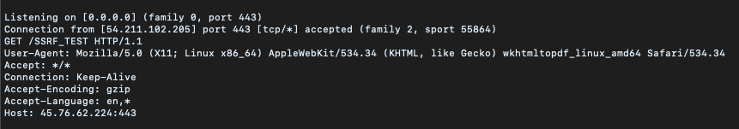
Simple XSS->SSRF via wkhtmltopdf
You notice HTML is rendering within your Generated PDF
we want to make sure this can communicate with other hosts
<iframe src=”http://myhost:myport:443”>

Slide 19
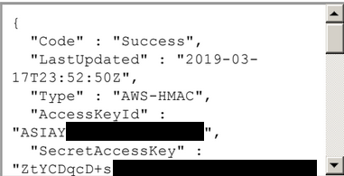
Simple XSS->SSRF via wkhtmltopdf
<iframe src=”http://169.254.169.254/user-data”>

Slide 20
When Simple Fails
Headless Chrome is great for PDF conversion tasks like this, but it makes it harder for hackers. Unlike wkhtmltopdf, it cares if you try to load an http resource inside an https page, like our previous example. Also unlike wkhtmltopdf, you can’t typically redirect it to another page and get a render of the new location.
Finally, the JS engine cares about Same-Origin Policy just like normal browsers do, so we can’t just make an XMLHttpRequest to the metadata service and steal their data that way.

Slide 21
HTML Renders but...
Most user input gets sanitized/filtered
We haven’t found an XSS in our target app
But… we are allowed to customize the fonts and styling of the generated PDF

Slide 22
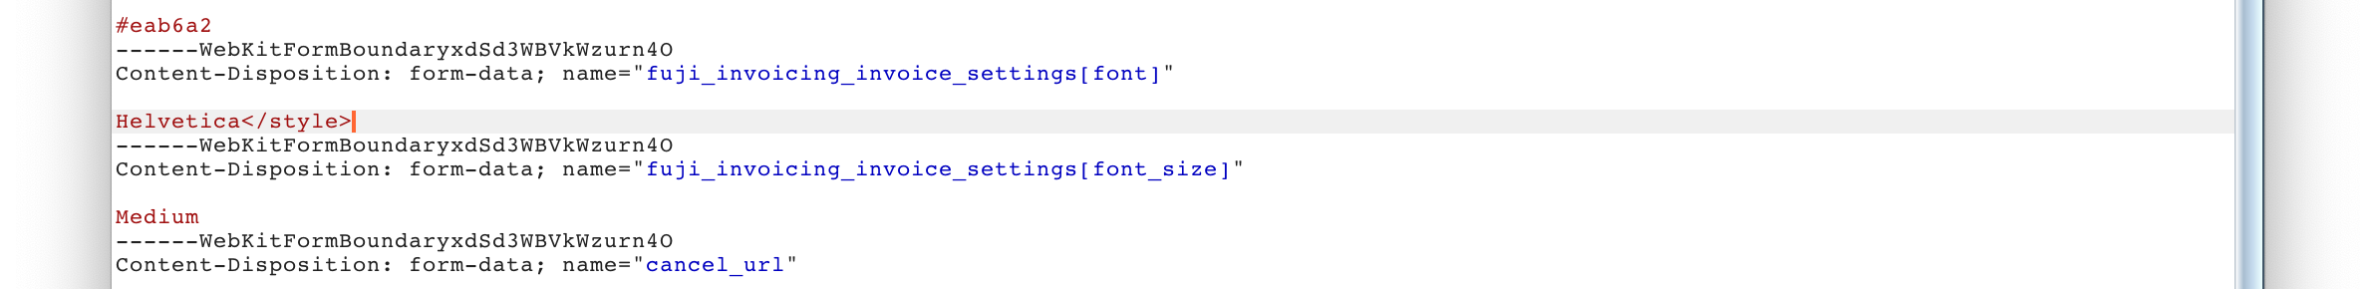
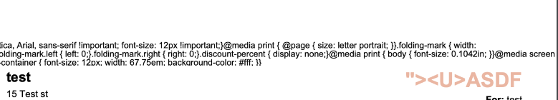
XSS via escaping <style> tag
Most user input gets sanitized/filtered
No XSS
But… we are allowed to customize the fonts and styling

Slide 23


XSS via escaping <style> tag
Confirm it renders HTML within the PDF Generator
Can it fetch anything from a remote host”?

Slide 24
XSS via escaping <style> tag
Replace test payload with <style><iframe src=”http://169.254.169.254/user-data”> and extract data:

Slide 25
WeasyPrint Makes Hacking (W)easy

Slide 26
WeasyPrint Makes Hacking (W)easy
… Once you know the trick, at least.
This one stumped us for a while. We got XSS into a PDF no problem, but there were two things that made this hard:
It didn’t seem to run any scripts, load iframes, or seemingly do anything but load images.
Every single payload we wanted to test required us to take a rideshare somewhere.

Slide 27
Use The Source
Once we got it to connect to a server where we could see the request, we noticed that the user agent said it was from WeasyPrint. A quick Google search later and we learned it was a pretty straightforward HTML renderer written in Python and it was open source!
Thankfully, we could run this locally and render pages just like the victim.
Unfortunately, this was when we got really pessimistic. This thing didn’t render anything fun. Text, some CSS, images -- that was about it.

Slide 28
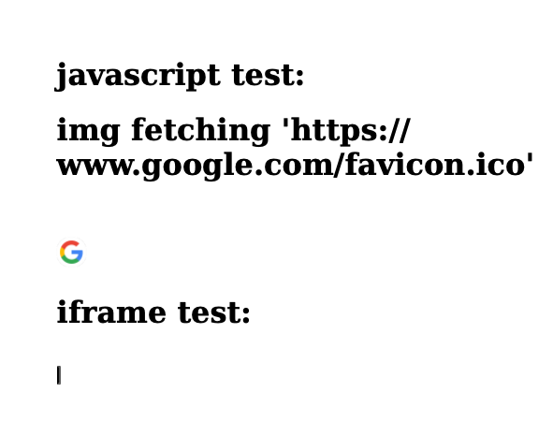
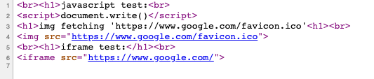
Use The Source
How does it work?
weasyprint input.html output.pdf
Example:

Slide 29
Use The Source
Only fetched images
No Javascript
No <iframe>
Html.py from WeasyPrint’s GitHub repository indicates we can use
<Img> 🛑

Slide 30
Use The Source
Only fetched images
No Javascript
No <iframe>
Html.py from WeasyPrint’s GitHub repository indicates we can use
<Img> 🛑
<Embed> 🛑

Slide 31
Use The Source
Only fetched images
No Javascript
No <iframe>
Html.py from WeasyPrint’s GitHub repository indicates we can use
<Img> 🛑
<Embed> 🛑
<Object> 🛑

Slide 32
Use The Source
Only fetched images
No Javascript
No <iframe>
Html.py from WeasyPrint’s GitHub repository indicates we can use
<Img> 🛑
<Embed> 🛑
<Object> 🛑
<Link> 🤔

Slide 33
Attachments
<link rel=attachment href=”file:///etc/passwd”>

Slide 34
Attachments
<link rel=attachment href=”file:///etc/passwd”>
This embeds files right into the PDF itself! They aren’t visible on the page, but they’re included as a hidden resource on the file.

Slide 35
Attachments
<link rel=attachment href=”file:///etc/passwd”>
This embeds files right into the PDF itself! They aren’t visible on the page, but they’re included as a hidden resource on the file.
We could not only read files, but make web requests. Three rideshares later, we had their full EC2 access keys.

Slide 36

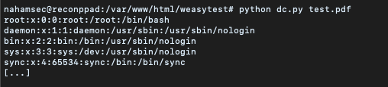
Attachments
Unpacks the content from pdf

Slide 37
DNS Rebinding for Fun and Profit

Slide 38
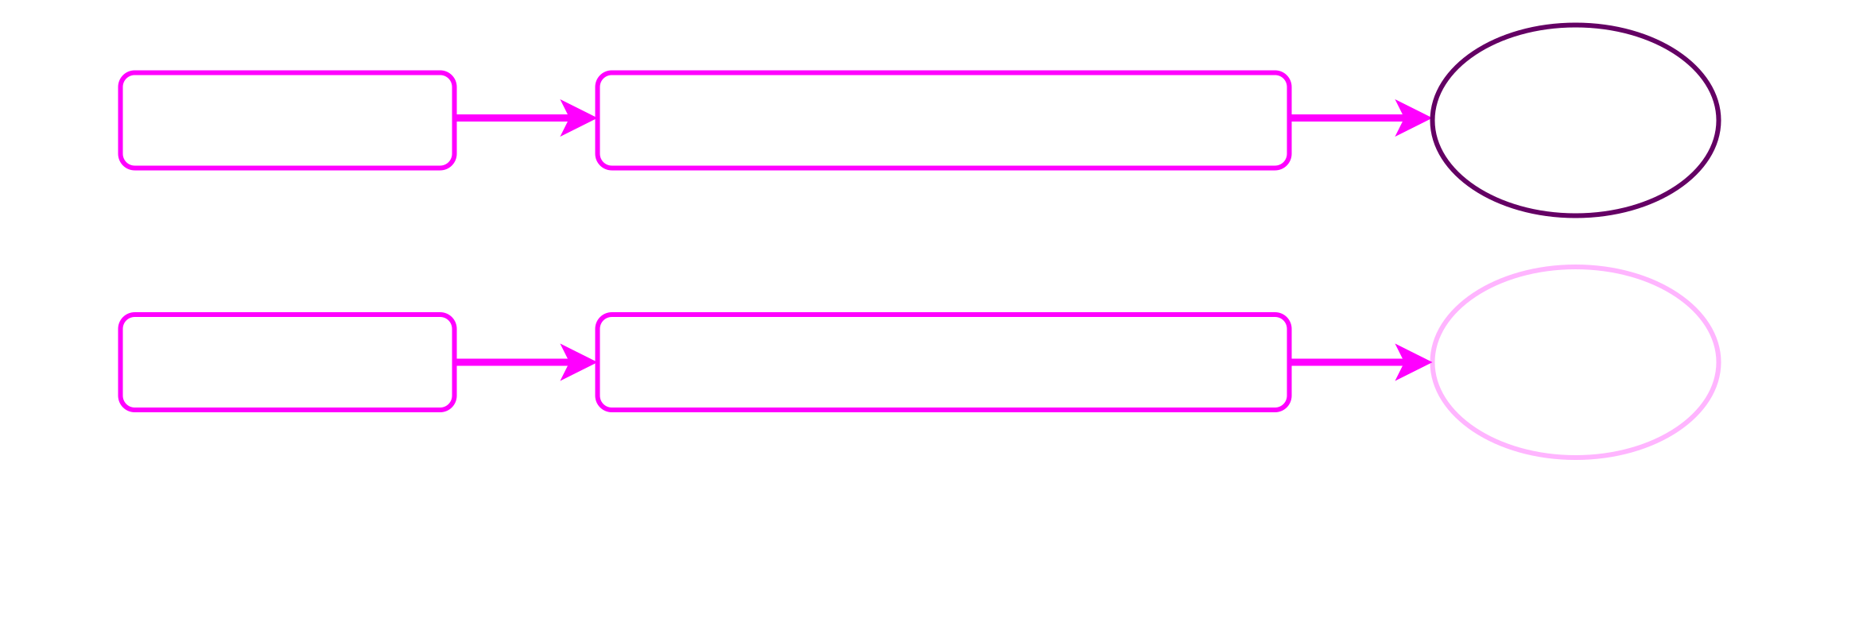
DNS Rebinding for Fun and Profit
DNS rebinding attacks provide a means to get around this. We make the browser think it’s requesting data from the same domain the page was loaded from and it’s game over.

Slide 39
DNS Rebinding for Fun and Profit
Browser loads http://ex.ploit.info/ and the script sends a message to the server to rebind ex.ploit.info to 169.254.169.254
The script then resolves a0.ex.ploit.info through a2499.ex.ploit.info, flushing the DNS cache for the original domain
Then the script can request any data from the metadata service using requests to ex.ploit.info; the metadata services don’t care what hostname is used to make requests to them
Data can be sent to bc.ex.ploit.info, which serves as a backchannel for exfiltration

Slide 40
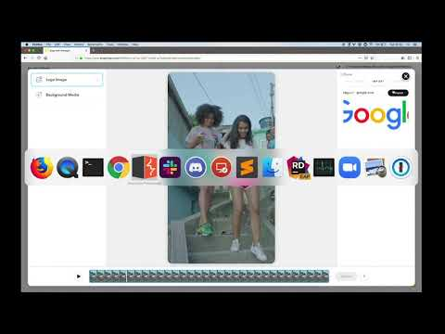

Slide 41
SSRF Tools

Slide 42
HTTPRebind
Rebinding attacks can be very valuable for SSRF, but they require a lot of setup work, tweaking, and programming. HTTPRebind combines a DNS server with an HTTP server to automatically handle all of this for you.
Usable against any headless browser
Takes only seconds to run due to DNS cache flushing
Automatically pulls critical data from GCP, AWS, and Azure
Get the source at https://github.com/daeken/httprebind

Slide 43
SSRFTest
This tool lets you quickly do a first-pass test for SSRF. It will record incoming requests for your different targets as well as automatically attempt to access and dump data from EC2 metadata service.
The optimal targets for SSRFTest’s automated functionality are real headless browsers living in the cloud, but it’s a useful starting point for any SSRF exploitation.
Get the code at https://github.com/daeken/SSRFTest or use the public instance at https://ssrftest.com/

Slide 44
Recap

Slide 45
Recap
SSRFs can be very dangerous
Don’t give up on your bugs until you have tried every possible scenario
WeasyPrint took us ~3 months to piece together
If you see a PDF generator somewhere, 9/10 it’s vulnerable
Especially if you chain with other vulnerabilities (XSS, Open Redirect, etc)

Slide 46
Recap
Disable Javascript
Create some good whitelisting
Properly configure your cloud instances to minimize impact
Be nice to hackers

Slide 47
Keep in Touch
me@nahamsec.com
Youtube/Twitch/social media: @NahamSec
Ben Sadeghipour
Twitter: @daeken
Hacker101 Discord
Cody Brocious

Slide 48
Thank You!

